Slide 1
Machine Learning
Neural Networks

Slide 2
Artificial Neural Networks
Computational models inspired by the human brain:
  Algorithms that try to mimic the brain.
  Massively parallel, distributed system, made up of simple processing units (neurons)
  Synaptic connection strengths among neurons are used to store the acquired knowledge.
  Knowledge is acquired by the network from its environment through a learning process

Slide 3
Applications of ANNs
ANNs have been widely used in various domains for:
  Pattern recognition
  Function approximation
  Associative memory

Slide 4
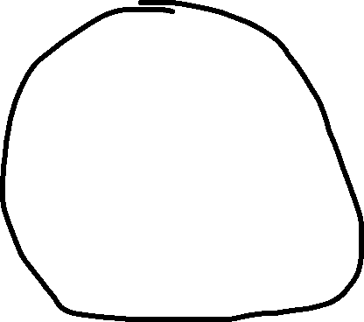
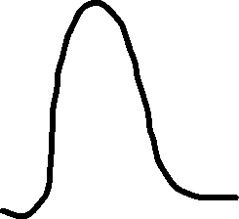









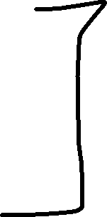
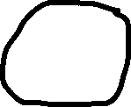

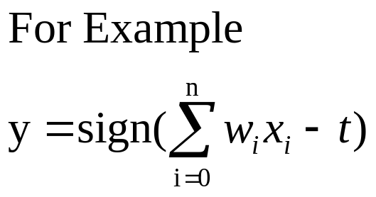
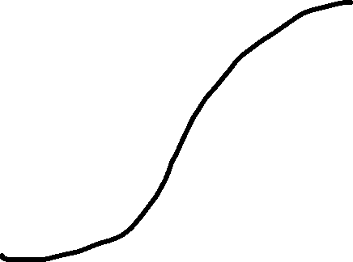
A Neuron (= a perceptron)
-
t
x₀
w₀
x₁
w₁
∑
f
output y
x_{n}
w_{n}
Input
vector x
weight
vector w
weighted
sum
Activation
function
The n-dimensional input vector x is mapped into variable y by means of the scalar product and a nonlinear function mapping
Data Mining: Concepts and Techniques

Slide 5
Perceptron
Basic unit in a neural network
Linear separator
Parts
  N inputs, x₁ ... x_{n}
  Weights for each input, w₁ ... w_{n}
  A bias input x₀ (constant) and associated weight w₀
  Weighted sum of inputs, y = w₀x₀ + w₁x₁ + ... + w_{n}x_{n}
  A threshold function or activation function,
    i.e 1 if y > t, -1 if y <= t

Slide 6
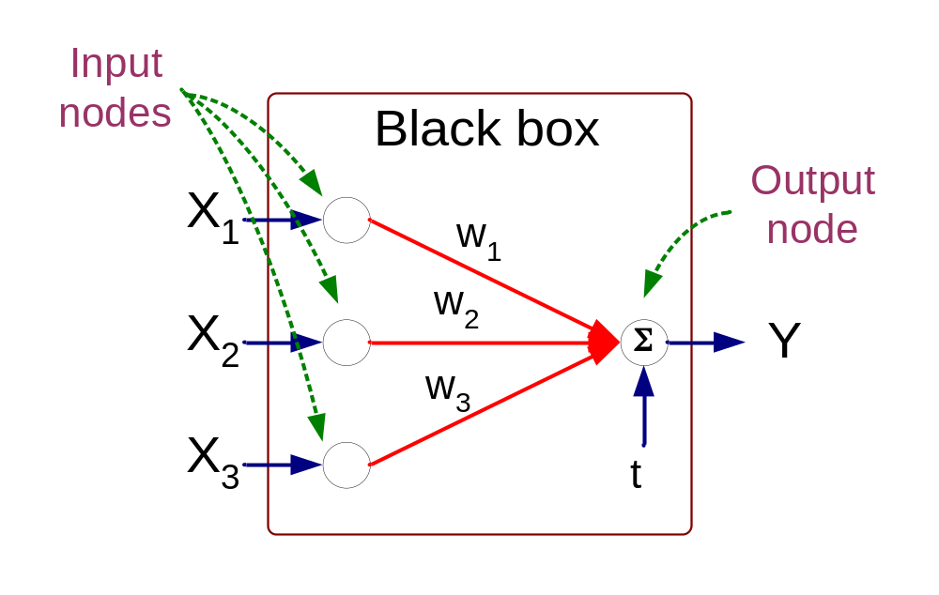



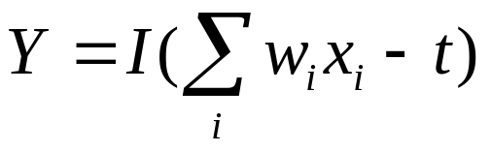
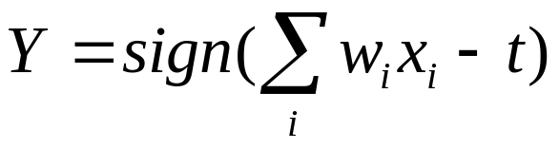
Artificial Neural Networks (ANN)
Model is an assembly of inter-connected nodes and weighted links
Output node sums up each of its input value according to the weights of its links
Compare output node against some threshold t
Perceptron Model
or

Slide 7





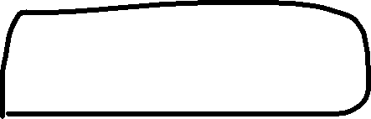




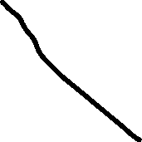


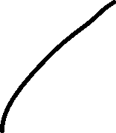







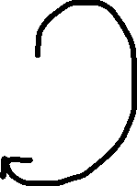

Types of connectivity
output units
Feedforward networks
  These compute a series of transformations
  Typically, the first layer is the input and the last layer is the output.
Recurrent networks
  These have directed cycles in their connection graph. They can have complicated dynamics.
  More biologically realistic.
hidden units
input units

Slide 8



Different Network Topologies
Single layer feed-forward networks
  Input layer projecting into the output layer
Single layer
network
Input Output
layer layer

Slide 9


Different Network Topologies
Multi-layer feed-forward networks
  One or more hidden layers. Input projects only from previous layers onto a layer.
2-layer or
1-hidden layer
fully connected
network
Input Hidden Output
layer layer layer

Slide 10
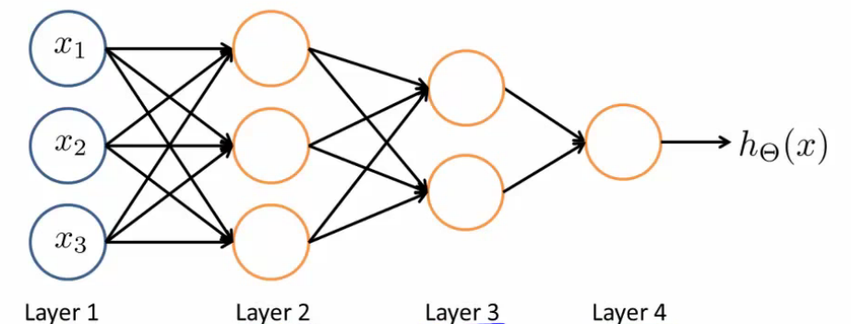
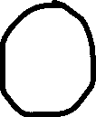


Different Network Topologies
Multi-layer feed-forward networks
Input Hidden Output
layer layers layer

Slide 11
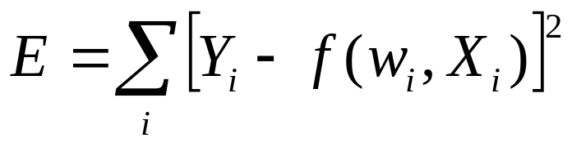
Algorithm for learning ANN
Initialize the weights (w₀, w₁, …, w_{k})
Adjust the weights in such a way that the output of ANN is consistent with class labels of training examples
  Error function:
  Find the weights w_{i}’s that minimize the above error function
    e.g., gradient descent, backpropagation algorithm

Slide 12
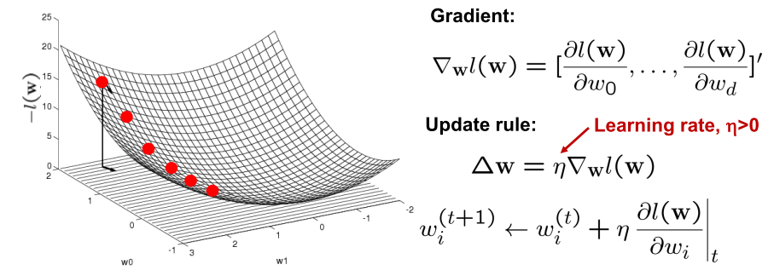
Optimizing concave/convex function
Maximum of a concave function = minimum of a convex function
Gradient ascent (concave) / Gradient descent (convex)
Gradient ascent rule

Slide 13
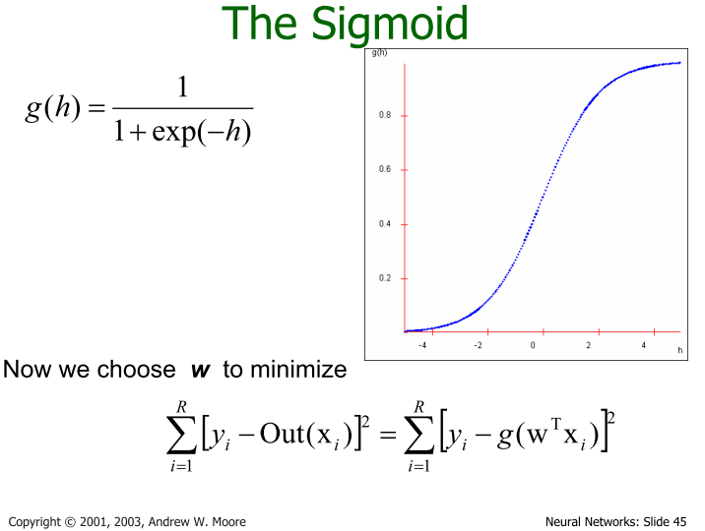


Slide 14
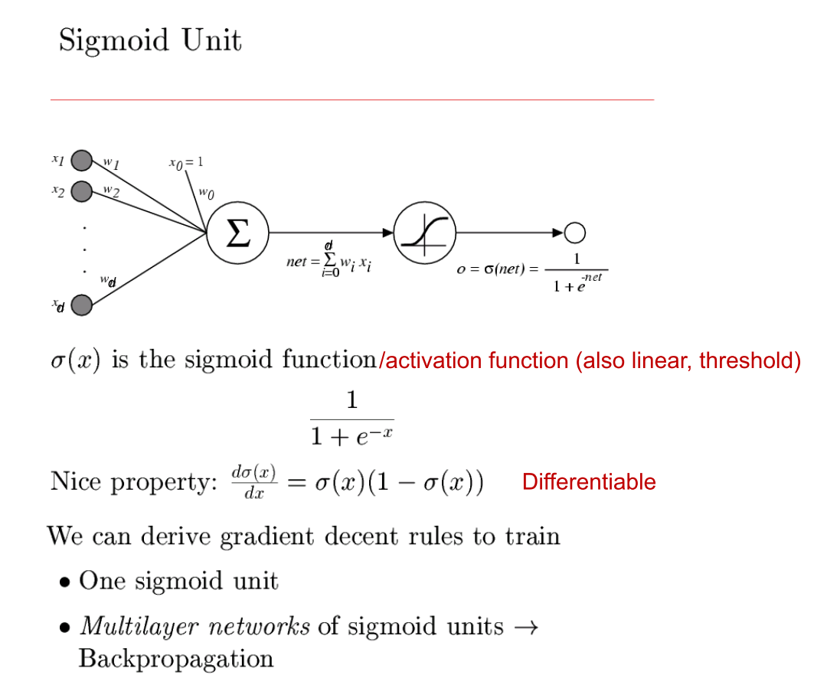




Slide 15







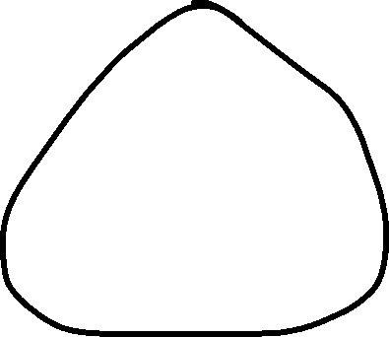










Backpropagation
Iteratively process a set of training tuples & compare the network's prediction with the actual known target value
For each training tuple, the weights are modified to minimize the mean squared error between the network's prediction and the actual target value
Modifications are made in the “backwards” direction: from the output layer, through each hidden layer down to the first hidden layer, hence “backpropagation”
Steps
  Initialize weights (to small random #s) and biases in the network
  Propagate the inputs forward (by applying activation function)
  Backpropagate the error (by updating weights and biases)
  Terminating condition (when error is very small, etc.)
Data Mining: Concepts and Techniques

Slide 16
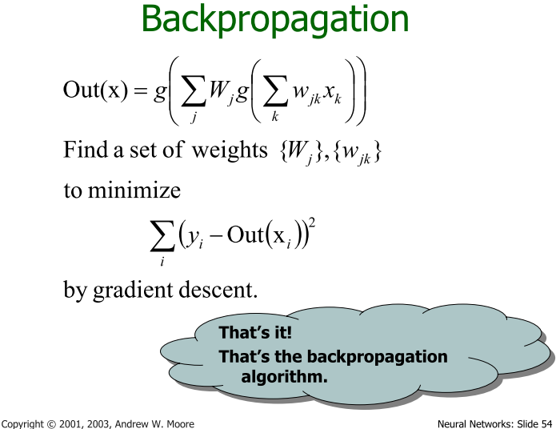




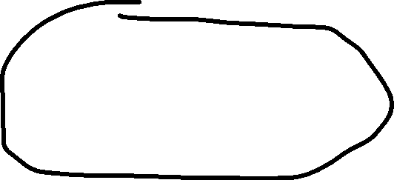











Slide 17




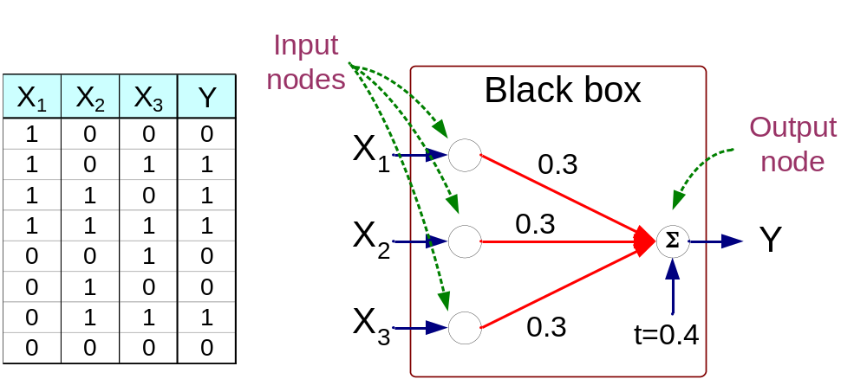


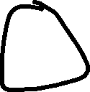








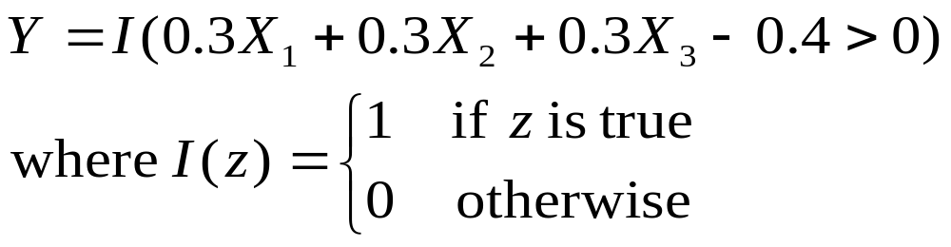
Artificial Neural Networks (ANN)

Slide 18
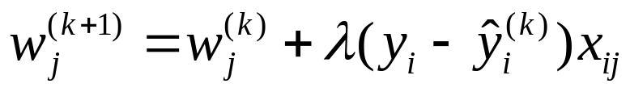
A Multi-Layer Feed-Forward Neural Network
Output vector
Output layer
Hidden layer
w_{ij}
Input layer
Input vector: X
Data Mining: Concepts and Techniques

Slide 19

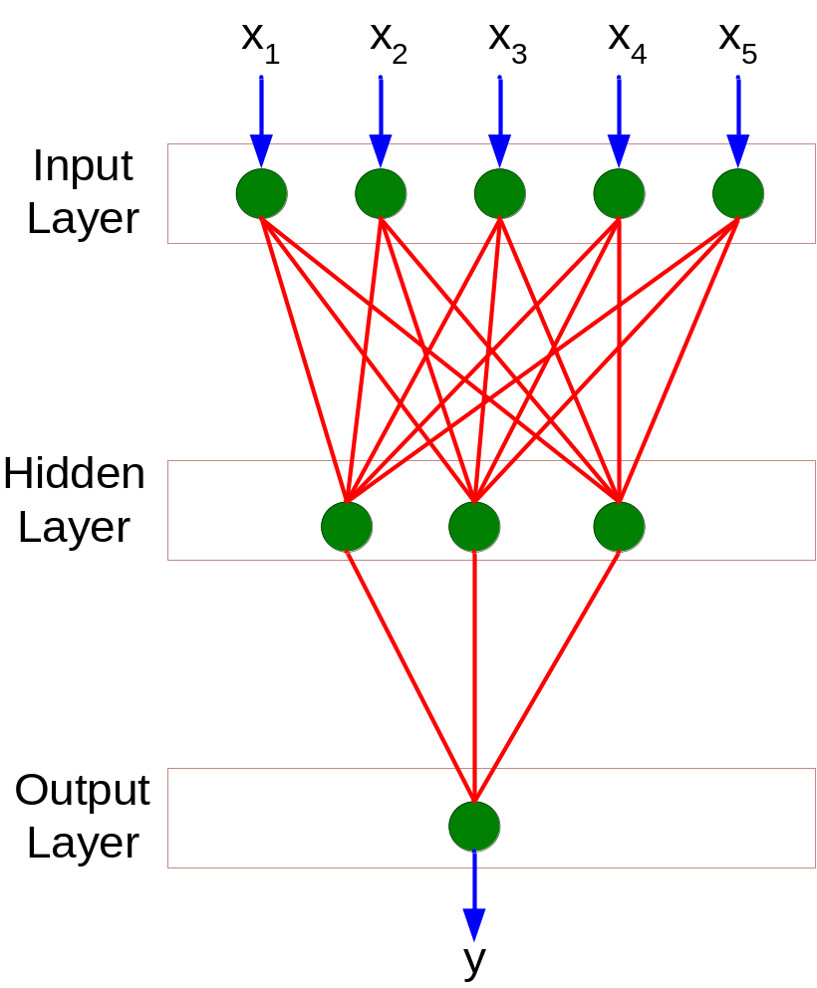

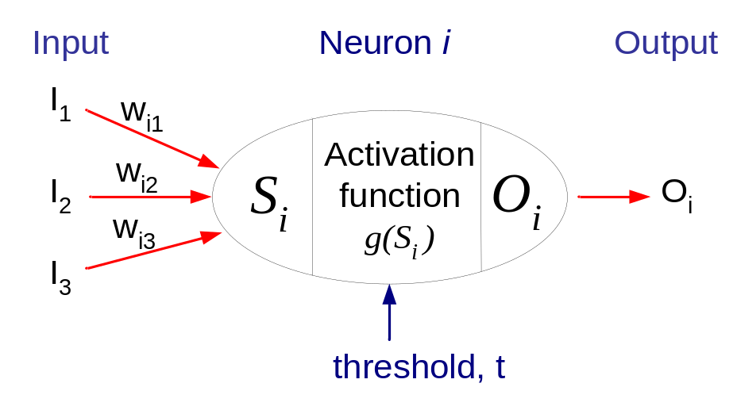


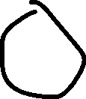








General Structure of ANN
Training ANN means learning the weights of the neurons

